Slide 1
On the inductive bias of language modeling:
From Statistical to syntactic dependencies
Tatsunori Hashimoto
Stanford CS
Based on work with Tianyi Zhang
Notes:
Welcome! I’m Tatsunori Hashimoto, and I’ll be speaking about some recent work by myself and my student Tianyi Zhang on understanding the inductive bias of language modeling, and why language models learn to capture structures such as syntax. (11s)

Slide 2
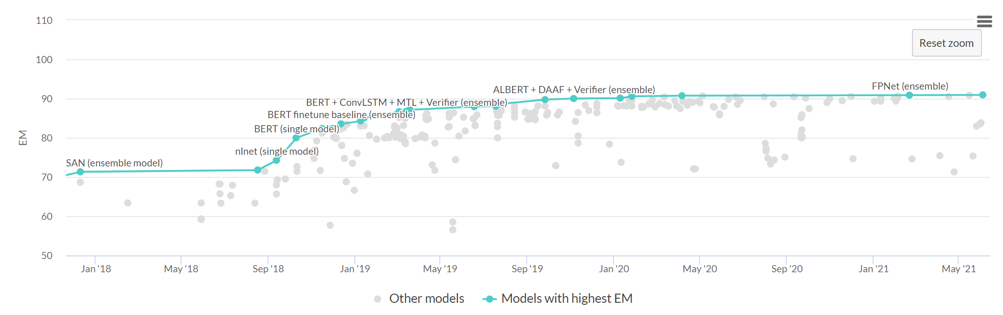
Language models power NLP systems today
Large gains in benchmarks powered by language models
Gains from pretrained language models
Squad 2.0 [PapersWithCode]
Notes:
Large language models have had an enormous and almost unavoidable influence – they have been behind some of the biggest gains in benchmark performance in NLP, and their use is ubiquitous in a range of downstream tasks.
Shown here is performance on the Squad 2.0 question answering benchmark, and the marked red gap is the large jump in performance attributable to the use of BERT. There’s a clear inflection point in performance where these methods began to be used. (25s)

Slide 3
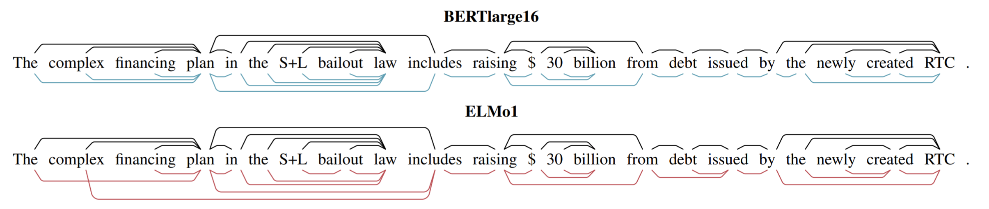
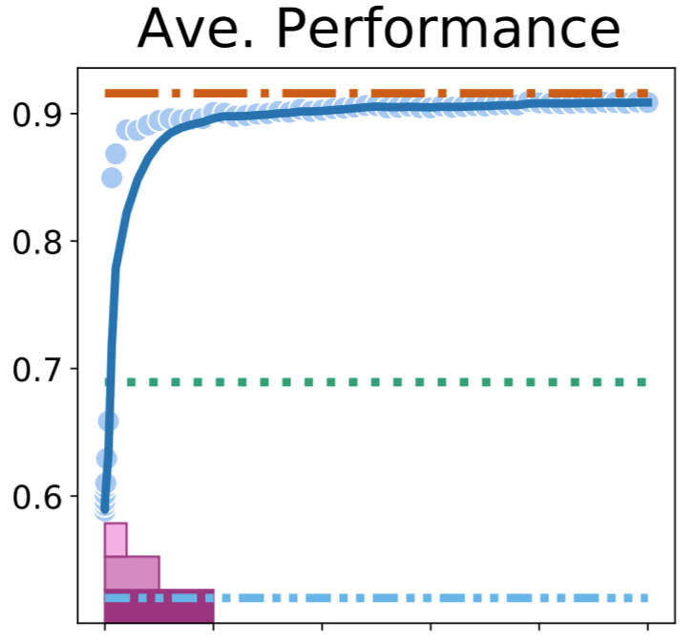
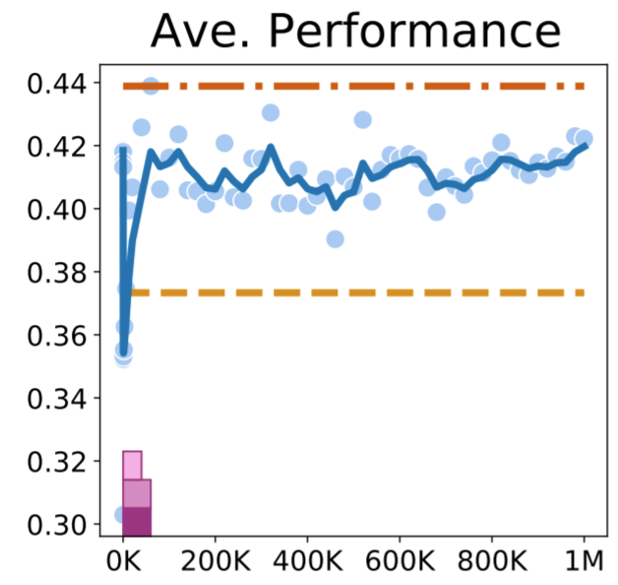
Intriguing emergent structures of language models
Interesting: these models learn useful linguistic structures without supervision
Hewitt and Manning 2019
Models seem to prefer certain structures over others
Accuracy
Accuracy
Liu et al 2021
LKT
(syntax)
Olympics
(reasoning)
Number of samples
Number of samples
Notes:
More intriguingly, careful investigation into these models have revealed that they seem to learn useful linguistic structures such as dependency parse structures without explicit supervision about syntax. Shown here in the top is undirected arcs from a dependency parse in black, and colored lines indicating arcs estimated by a linear classifier trained on the internal representations of BERT.
It is surprising that simple, task-agnostic supervision leads to these kinds of structures.
Recent investigations have further shown that its easy for these models to learn syntactic structures compared to others. The example shown here suggests that near perfect accuracy can be achieved on many syntactic probing tasks with tens of thousands of samples on the left, but these same representations seem to fail reasoning tasks regardless of the number of samples on the right. This is a bit of a mystery – task agnostic self supervision seem to encourage language models to naturally learn some structures, but not others. (53s)

Slide 4
What do we know?
We know what they learn
We know what can be learned
Large literature on probing
Fill-in the blank (cloze)
Lee et al 2020
Saunshi et al 2020
Belinkov 2017
Hewitt and Manning 2019
Voita and Titov 2020
Liu et al 2021
Hidden Markov models
Xie et al 2020
Today’s talk: inductive bias – what do these models prefer to learn (and why)
Notes:
What do we know about these properties?
On the one hand, there’s a large literature on probing tasks that try to understand what types of structures are embedded inside the representations of these models, and we have a decent understanding of what information is contained in these representations, and the complexity of the probes required to recover them.
On the other hand, recent advances in theoretical understanding of language modeling have characterized conditions in which pre-training can provably recover certain latent structures, such as recovering latent variables in fill-in-the-blank tasks, or recovering hidden Markov models via language modeling.
There is, however a gap in our understanding when trying to explain the observed empirical phenomena from probing using these theories. We know what structures are learned by language models, and what types of toy models these language models can capture, but we do not yet understand why language models seem to naturally learn structures such as syntactic parse trees from task-agnostic supervision. (54s)

Slide 5
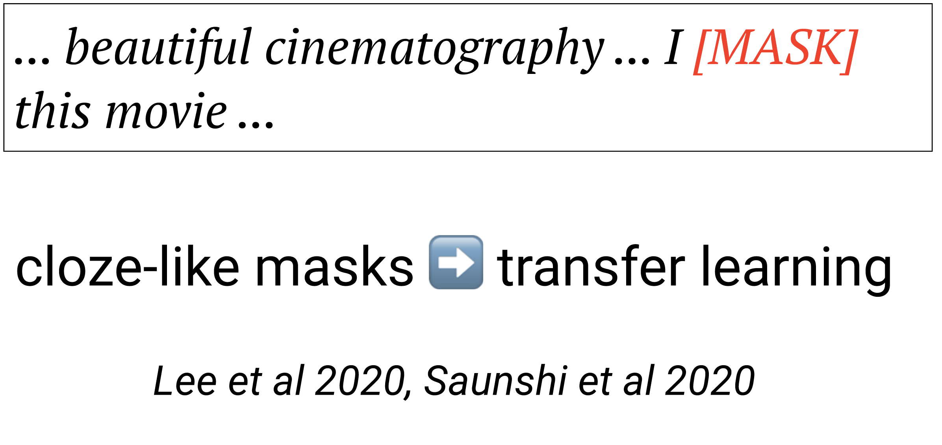
The cloze hypothesis for language modeling
Cloze hypothesis:
Language models learn useful structures, because filling in the blank directly relates to downstream tasks
Example (sentiment classification)
Well-established theory (Saunshi et al 2020, Lee et al 2020)
Notes:
As a starting point, we can think a bit about what I will call the cloze hypothesis.
In this hypothesis, language models acquire representations that are useful for downstream tasks, because language models are trained to fill in blank masks, and filling in the blank can sometimes directly provide supervision for downstream tasks.
As an example, in sentiment classification we might have a case where the model has to fill in – I [MASK] this movie. Clearly, our ability to fill in the mask is closely related to our ability to understand the sentiment of the rest of the review. Because of the direct link between downstream task and the language modeling problem, there is well-established theory for studying these situations. (41s)

Slide 6
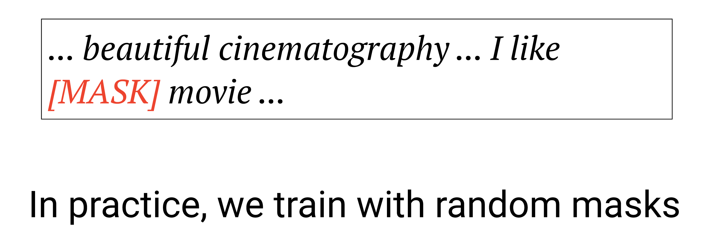
In practice: we learn with random, not cloze masks
In practice we train with random, not cloze-like masks
How much of the gains come from..
Cloze-like masks providing task-specific supervision
vs
Random masks providing more generic inductive biases
Notes:
However, this really fails to explain the actual behavior of language model training, because the vast majority of masking problems have nothing to do with a specific downstream task.
As an example, we might mask out the word the in the sentiment example, in which case we get no supervision for any downstream task. It is these more generic masks that are most likely providing the inductive bias and structures identified by probing studies.
Is there a way for us to understand how much of the gains for language models come from the task-specific masks as suggested by the cloze hypothesis, and how much of the gains come from these random masks. (30s)

Slide 7
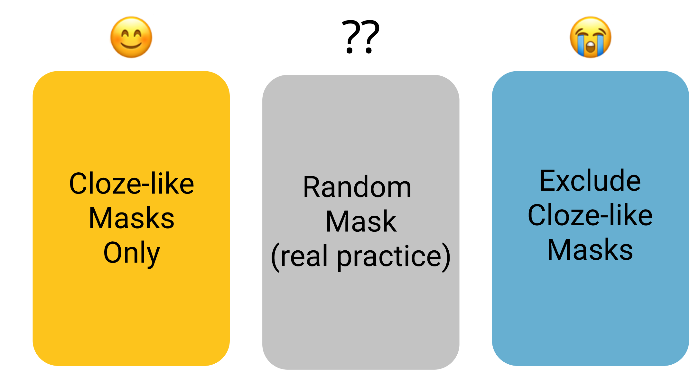
Testing the cloze reduction hypothesis
Notes:
We can answer this question with a simple controlled experiment.
If we restrict ourselves to tasks such as sentiment classification, we can come up with 3 different types of ways to train language models. On the left, we can train the model purely on these cloze like masks, where we identify sentiment words using a lexicon, mask those out, and ask the language model to fill those in.
On the right side, we can consider the other extreme, where we remove all these cloze-like masks, and only consider masking generic words. Finally, we can compare the performance of these two language models to random masks that are used in practice. (37s)

Slide 8
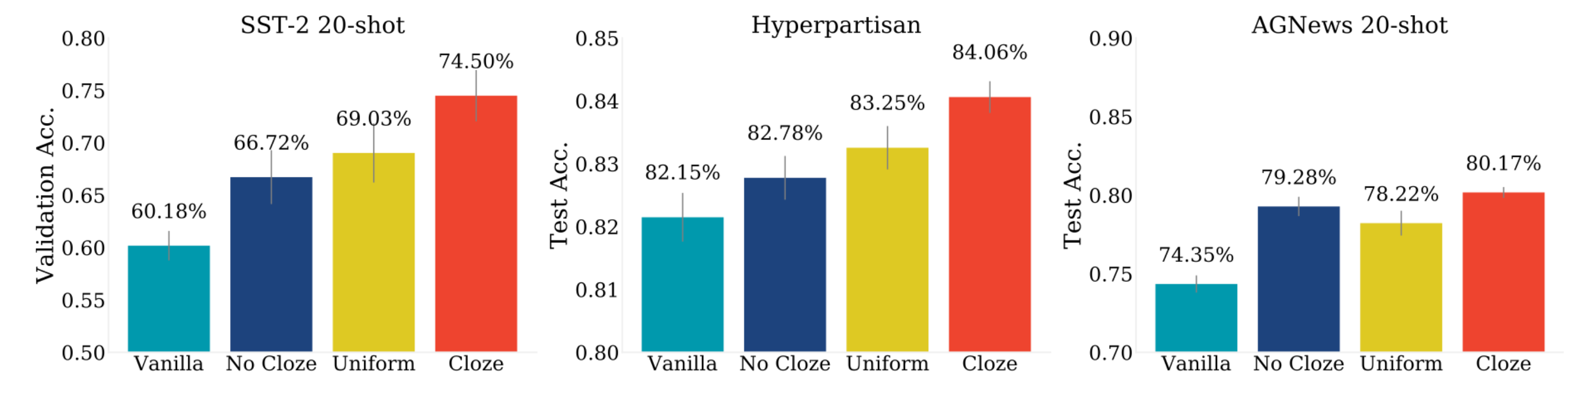

Cloze reduction fails to explain gains
Sentiment classification
Partisanship detection
Topic classification
Cloze-based
pretraining
gains
Almost no difference between no-cloze and uniform
No-cloze captures ~half the gains
1. Cloze-like masks work
2. No-cloze does too
3. Uniform $≈$ No-cloze
Takeaway: Uniform masks used in practice do not behave like cloze reductions
Details in Zhang and Hashimoto, NAACL 2021
Notes:
Since we don’t have the computational ability to train these models from scratch, we used a trick called continued pretraining, and updated a basic BERT model on the 3 types of masks across 3 tasks.
Vanilla indicates the performance without any of this continued pretraining, and we see that using cloze like masks gives huge gains. This is expected, and goes along with the established theory of cloze like masks.
What happens with masks that are not cloze-like? We actually find that even after removing cloze-like masks, we see almost 50% of the gains due to pretraining performance. This is really surprising! We explicitly removed task specific supervision, but still got gains on downstream tasks.
Even more surprisingly, we find that there’s almost no difference in performance between randomly masking tokens, and no-cloze masks where we explicitly remove supervision. This suggests that masked language modeling works not due to the cloze reduction, but because there’s useful signal beyond direct fill-in-the-blank supervision for downstream tasks.
What’s missing? (56s)

Slide 9
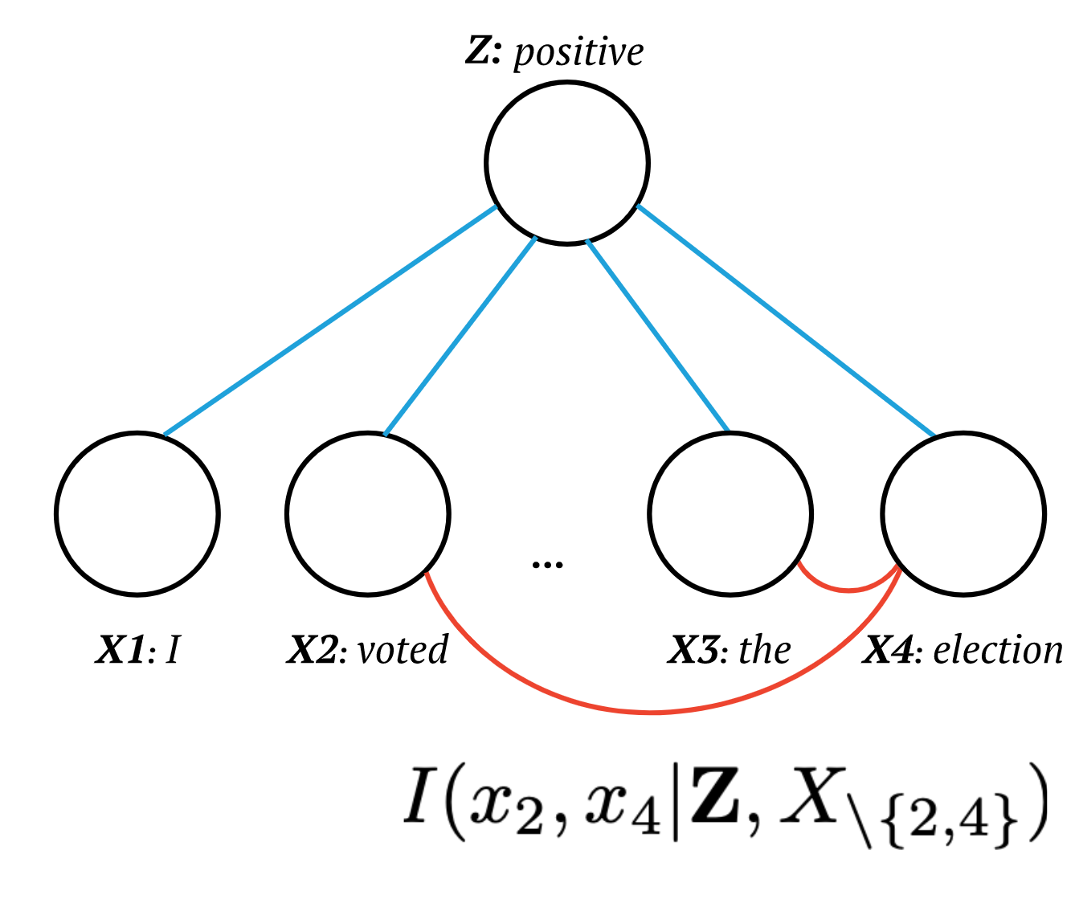
Alternative views: looking to other ‘masking’ tasks
Masking:
Predicting some masks from the rest
Dependency estimation:
Estimating whether masks can be filled in accurately
CMIT algorithm for
graphical model estimation
Bert-like masking
[Anandkumar et al 2010]
High level: modeling masks makes the model learn statistical dependences
Details in Zhang and Hashimoto, NAACL 2021
Notes:
To try to understand this, we knew that we had to understand how generic masks worked, and we looked towards other algorithms which also rely upon fill-in-the blank style prediction tasks and to understand these connections.
One major class of algorithms that rely on fill in the blank prediction problem is the classic “graphical model structure estimation” algorithms. For example, the CMIT algorithm for estimating conditional independences in a graphical model consists of repeated tests of whether pairs of variables can be reconstructed given the remaining ones.
The connection here is pretty direct. BERT type language modeling seeks to mask some tokens and fill it in as a way to learn representations that are useful for predicting relationships among tokens. CMIT style graphical model structure estimation algorithms seek to mask variables and reconstruct it as a way to see whether there is strong dependence among variables.
This brings us to the high level point – masked language modeling is naturally designed to learn statistical dependencies among token positions in a sentence (57s)

Slide 10
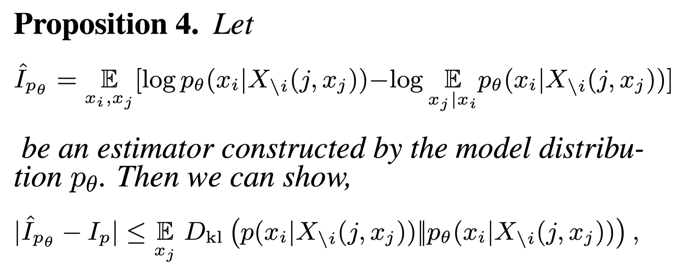
MLMs learn statistical dependencies
Formally – the masking objective of BERT ensures good estimates of dependence
Model’s estimate of mutual information
Approximating dependence
Bert masking objective (logloss)
Details in Zhang and Hashimoto, NAACL 2021
Notes:
We’ve shown this formally in recent work and I’ll refer you to our paper for full details, but I want to describe the high level connection.
First, since a masked language model gives a probability distribution over masked tokens, a language model implicitly estimates the dependence between any two tokens. Here, we’re going to write down the conditional mutual information estimated by the model as I-hat.
What we can show is that the model’s estimate of dependence, and the true dependence must be similar, as long as the masked language model achieves low loss.
More precisely, if a language model has low log-loss on fill-in-the-blank tasks which is the term on the right of this inequality, then this log-loss upper bounds the approximation between the language model’s internal estimate of conditional mutual information, and the true population conditional mutual information.
Thus, common masking objectives serve as a surrogate upper bound to learning statistical dependence. (52s)

Slide 11
Validation: from statistical to syntactic dependence
Hypothesis:
Learning statistical dependencies is useful because it correlates with useful linguistic structures such as syntax
This is consistent with earlier observations that MLMs seem extremely good at learning syntactic structure (compared to reasoning tasks).
How can we validate this hypothesis?
Recover the statistical dependencies learned by BERT
See whether these dependencies correspond to edges on a dependency parse
Notes:
This is all nice, but why do we care?
Let’s return to our opening question – why do masked language models seem to learn syntactic structures so naturally? We might hypothesize that it is because these models are learning a different type of dependence among tokens – statistical dependence.
This is a testable hypothesis of the theory. If this is true, then we should be able to first recover the statistical dependencies learned by large language models such as BERT, and then we can use these dependencies to construct a parse tree, and evaluate this procedure as an unsupervised dependency parser. (34s)

Slide 12
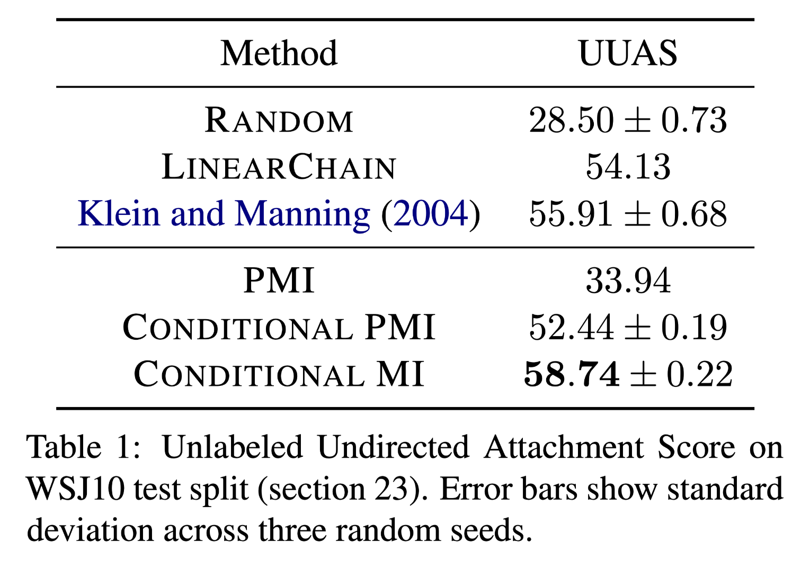
Inductive bias of MLMs enable unsupervised parsing
Finding: Conditional mutual information from BERT works as well as a classic unsupervised dependency parser
Ablations:
Changing the type of
dependence hurts performance
Notes:
It turns out that literally just using conditional mutual information from BERT serves as a reasonably good unsupervised dependency parser, even outperforming the classic DMV algorithm from klein and manning.
Even nicer is the observation that minor changes to the type of statistical dependence we measure seems to decrease performance, and that the type of dependence being implicitly measured by BERT style masking is the best out of those that are plausible to try.
This is a somewhat surprising finding from the empirical perspective as well – it was widely considered that mutual information alone could not serve as a dependency parser, and this low-performance PMI baseline was considered and ruled out in the original klein and manning paper. It’s a nice side effect that studying the theory of masked language modeling leads to an observation that certain types of statistical dependence do relate closely to dependency parse trees. (50s)

Slide 13
Takeaways
Open problem: characterizing the inductive bias of LMs
(cloze reductions are only part of the picture)
Our approach: statistical dependences as the goal of MLM learning
Validation: inductive bias of MLMs enable unsupervised parsing
(recent work such as PMI-masking give additional empirical validation)
Notes:
To wrap up, there’s three key points to this talk.
First, I want to pose an open problem and a call to action – we have very little understanding of inductive biases of LMs, and why these models naturally learn some structures and not others.
Second, we proposed one way to answer this, via statistical dependence estimation, but of course this is likely just the tip of the iceberg.
Lastly, this hypothesis led to an interesting validation and finding, that statistical dependences in Masked LMs directly encode syntax. It’s also encouraging to see that there’s been recent work, such as PMI-masking from AI21 that demonstrates that these mutual-information based approaches can lead to improvements in the language model training as well. (41s)

